Slide 1
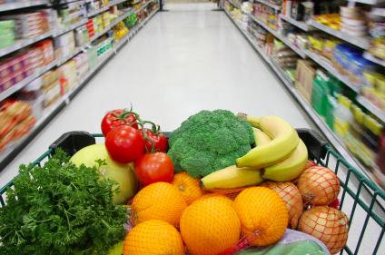
Grocery list application

Slide 2

Scenario 1: Register & Login
Step 1: User finds registration page
Step 2: User completes registration page and creates the account
Step 3: User confirms the account was created by logging in
* User should navigate between only Favorites and Reminder tab before Scenario 2*
Question 1: What are your biggest dislikes about the interface so far and why? Why?
Question 2: If you could add or redesign the features you have seen so far, what would you change/add and why would that be beneficial?

Slide 3

Scenario 2: Add Item to shopping list
Step 1: User is asked to find and click button for adding new item to shopping list. The shopping list page should be empty except for two buttons since the user is a new user.
Step 2: The category of the items is snacks and the name is pretzel
Step 3: User needs to add the item
Step 4: Once user is taken to confirmation page, they can log out
Question 3: Now that you have completed the scenarios, do you have any other likes/dislikes about the interface?
Question 4: Would you use this application for your grocery shopping needs? If so or if not, why?
Question 5: Would you prefer item visuals of pictures, words for the items or both?

Slide 4
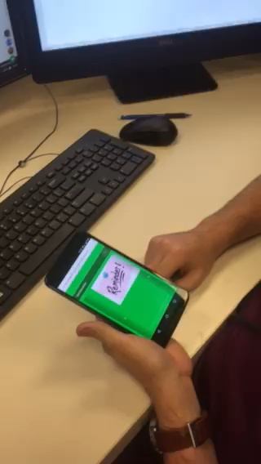
User Feedback #1 – Video
Video Scenario 1:

Slide 5
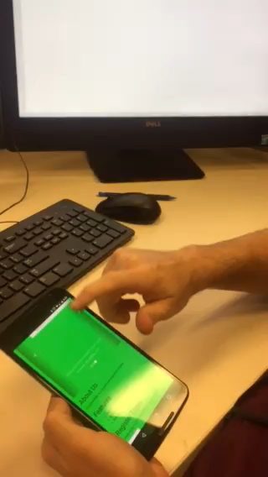
User Feedback #1- Video
Video Scenario 2:

Slide 6
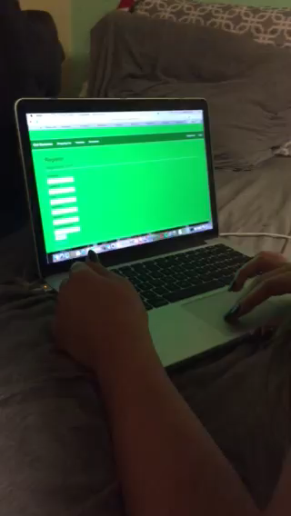
User Feedback #2 – Video
Video Scenario 1:

Slide 7
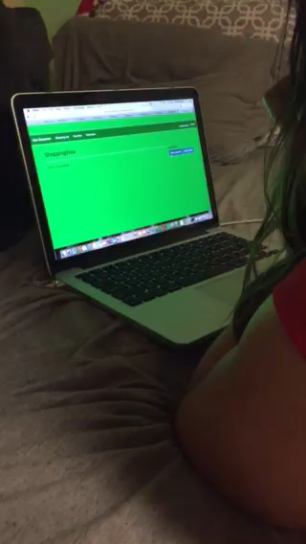
User Feedback #2 – Video
Video Scenario 2:

Slide 8
User Feedback #3
User did not feel comfortable being recorded but provided useful feedback
Question 1: Registering through laptop: Colors, the green was too green, the colors for some of the pictures are boring, captions for photos are odd, spelling errors.
Question 2: Change colors to make app more appealing for users, “Register Today” button does not work.
Question 3: No, the colors are just very unappealing
Question 4: Yes I would, it’s so handy; it would be cool if you could customize items and just add to the list!
Question 5: I would prefer words for the items.

Slide 9

Functionalities are great!
People will actually use and benefit from this app!
User interface needs a few tweaks
Ensuring that all buttons are working accordingly

Slide 10
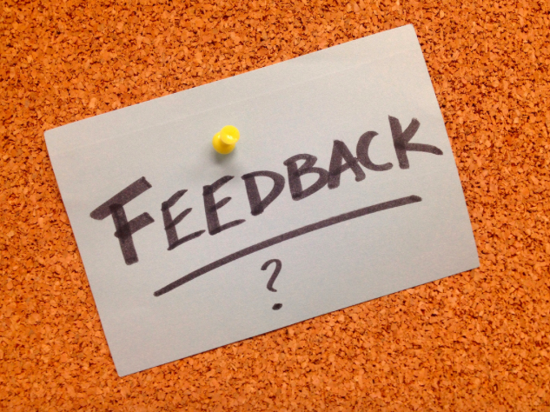
http://grocerylistapplication.azurewebsites.net/Home/Index

